Slide 1
Common App Guide
This guide provides information on how to:
Order Transcripts
Receive a Common App fee waiver
Request Recommendations

Slide 2
Ordering transcripts FOR the Common Application
Follow this Step- by -Step guide so you only PAY ONE TIME

Slide 3
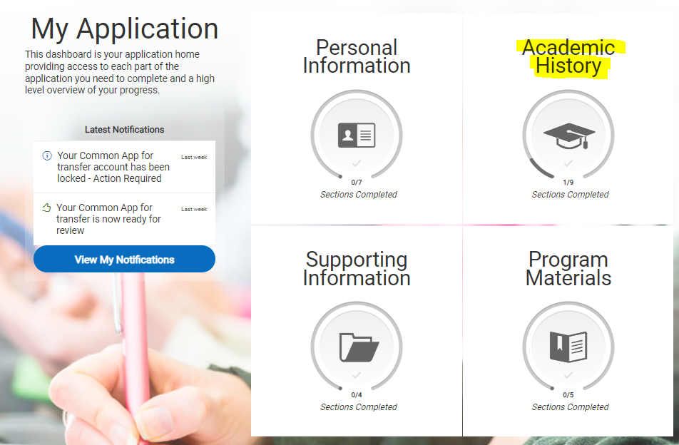
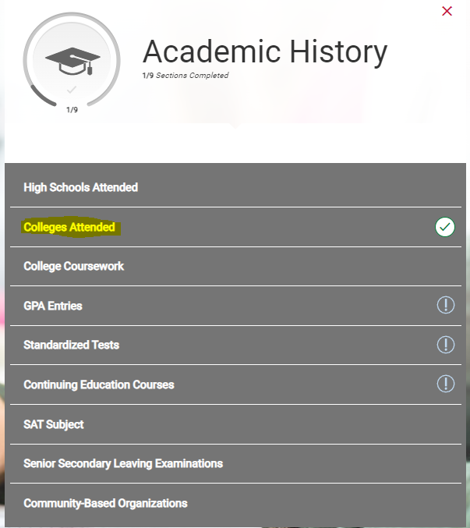
Electronically send transcript
Step 1.
Locate the correct page
"Academic History"
Step 2.
Click "Colleges Attended"

Slide 4
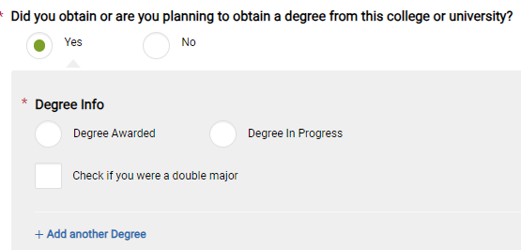
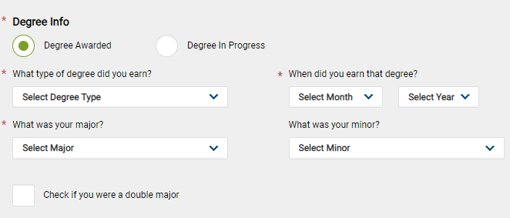
Step 3.Add QCC
Name of College
1
Option 1. Follow this process if you have GRADUATED
Have you OR do you plan on graduating?
2
3
Click here if have you already received your degree
Answer the degree questions
4
Click "Add College"
Step 4.
Follow 1of the 3 Options for ordering your transcript

Slide 5
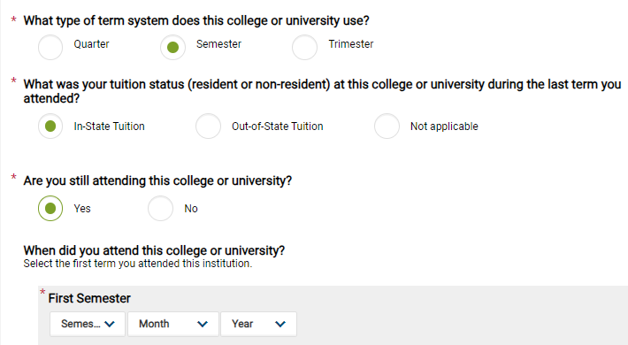
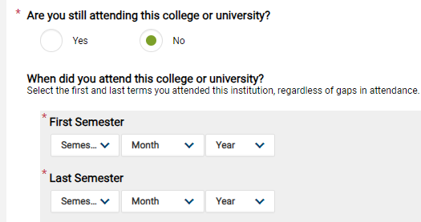
Option 2. Follow this process if you are planning to Graduate AND your classes are still in progress
Have you OR do you plan on graduating?
QCC does "Semesters"
1
3
Click here if you have NOT graduated & answer the questions
2
4
Choose Resident/non-resident
5
Click "yes" if you are currently enrolled in classes
Date of your first & last semester at QCC
5
Click "No" if you are NOT enrolled in classes
6
Date of your FIRST semester at QCC
6

Slide 6
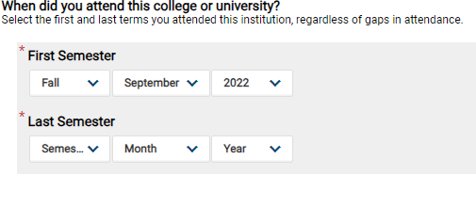
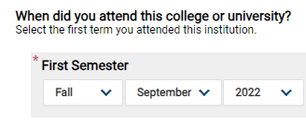
Option 3. You DO NOT plan to Graduate with your associates
1
You are NOT planning on obtaining your degree
2
QCC does "Semesters"
3
Choose Resident/non-resident
Are you currently enrolled?
4
No
Yes

Slide 7
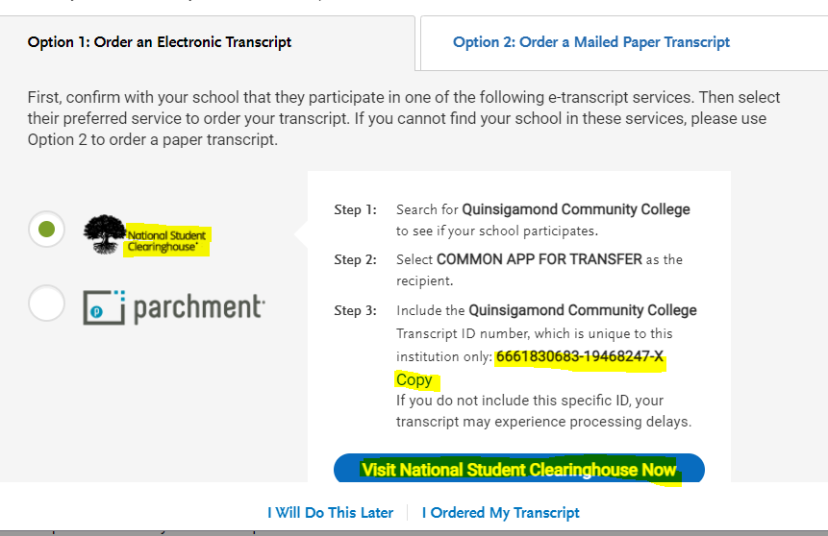
Step 6. National Student Clearing House
Step 5. Order Transcripts
QCC uses National Student Clearing House
Click "Copy" so you have your unique Transcript ID ready for National Student Clearing House
1
2
Click this button to continue the ordering process on Clearing House
1
3
Click Order

Slide 8
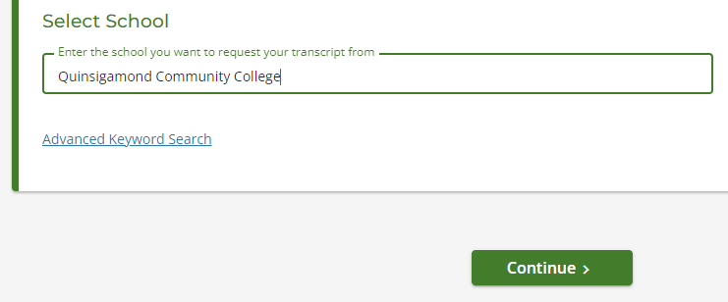
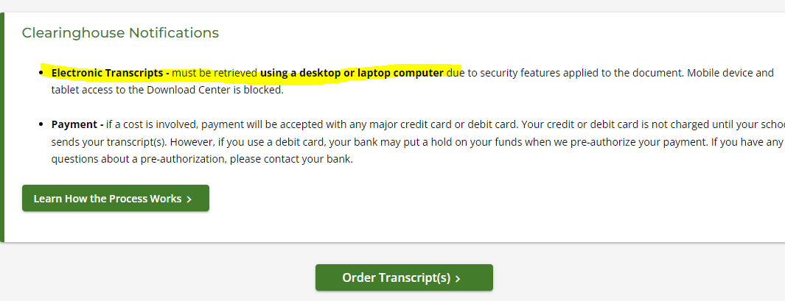
Step 7. Select School
Step 8.
Click "Order Transcript"

Slide 9
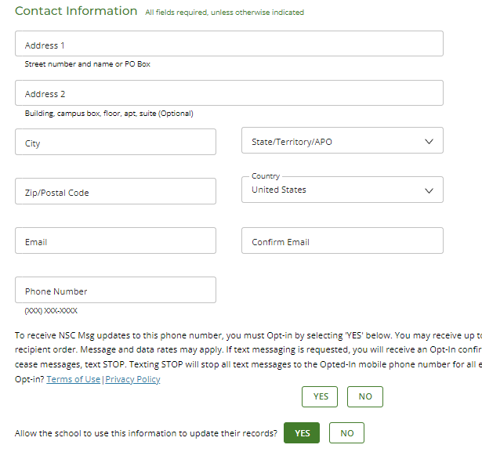
Step 9. Put in your personal information

Slide 10
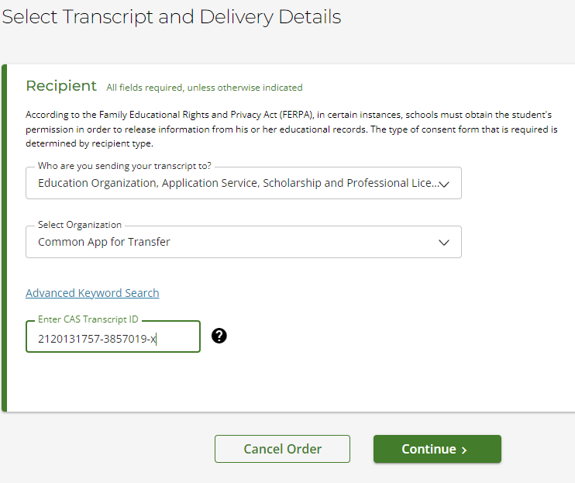
Step 10: Select Transcript Recipient
1. Choose “Education Organization, Application Services, Scholarship and Professional Licensing”
1
2. Choose “Common App for Transfer”
2
3. Enter the unique Transcript ID Number that you received in Step 6
3

Slide 11
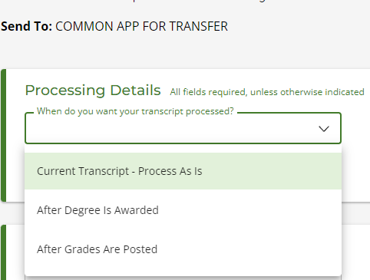
Step 11. Transcript Processing
Current Transcript- Process As Is-Use this option when ordering for current semester BEFORE degree is awarded/grades are posted. Use this option to send transcripts by application deadline
After Degree is Awarded – GRADUATING? Use this option when ordering FINAL transcripts
After Grades Are Posted- Transferring BEFORE graduating? Use this option when ordering FINAL transcripts

Slide 12
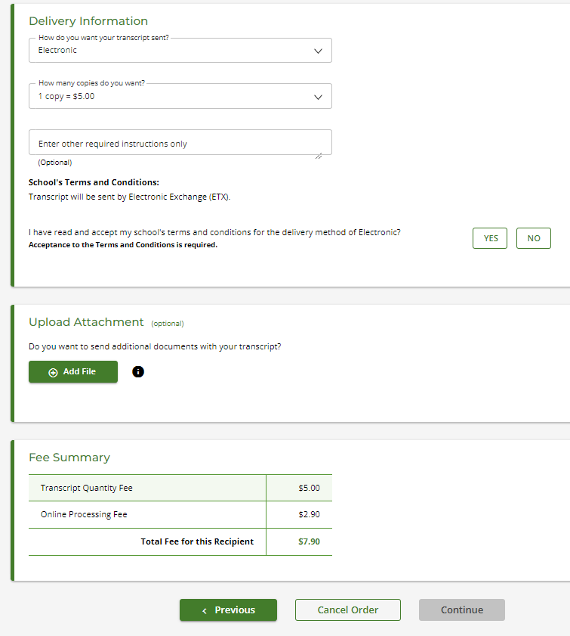
Step 12: Student Clearing House
1
Send "Electronically"
2
You only need “1 Copy” since you are using the Common App.
3
Click “Yes” to accept terms and conditions.
4
. “Continue” and pay for transcript.

Slide 13
Step 13: Pay For Transcripts
OPTIONAL : If you would like to send additional transcripts to a schools that are NOT on the Common App you can choose to "Add Recipient" to send to other schools.
Click "Checkout" when you are ready to pay.
The next 2 pages will ask for a signature and a payment method.

Slide 14
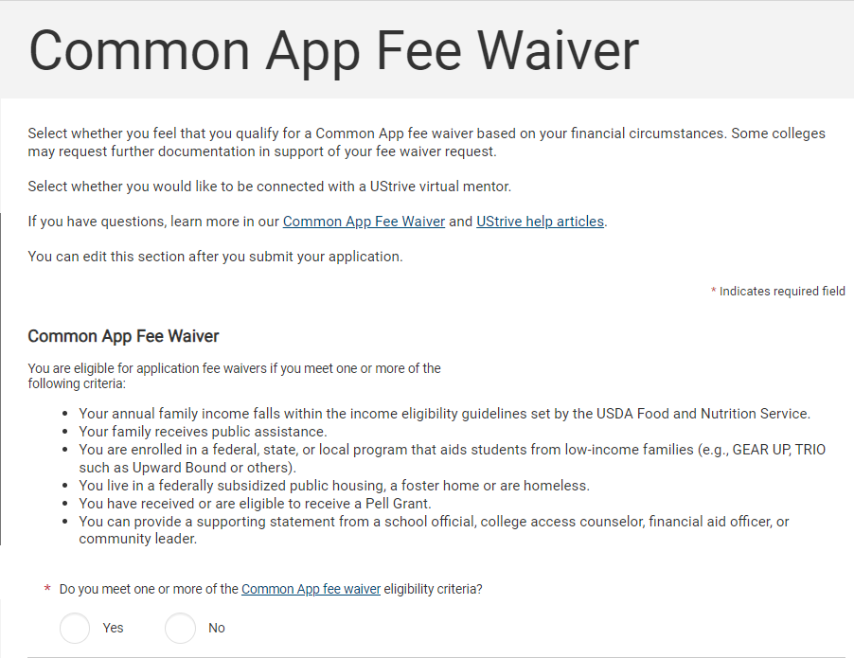
QCC Transfer office can provide supporting statement.
Click "Yes"

Slide 15
When students check “YES” they can still fill out the entire application and submit it.
Common App Fee Waiver
If a student checks “Yes” indicating that they meet one or more of the eligibility requirements, they have options.
THE STUDENT can provide a supporting statement
OR
2. TRANSFER SERVICES can provide a supporting statement
When students check “YES” the request shows up on the application when the school downloads it.
The receiving institution will review the file to see if the student qualifies for a fee waiver.
If the student receives a request for Fee Waiver Documentation from the Receiving School
Email Transfer@qcc.mass.edu Include your Student ID, Name, and the name of the school you are applying to.

Slide 16
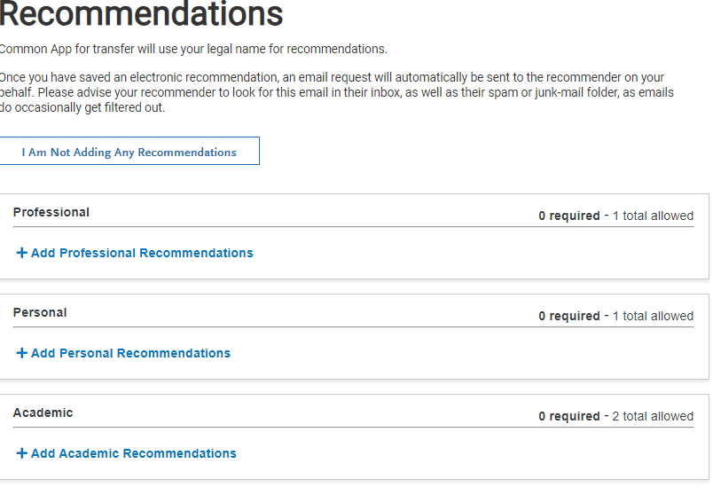
Recommendations
Before assigning someone, ASK instructor/professor first. Email is a great way to communicate but be sure to include the following information.
Academic should be a College Professor or Advisor
Introduce yourself: remind instructor who you are: class taken with professor, when, ect.
Academic goals and to which school you are applying
Share the submission options (online OR hard copy)
Please be Respectful when monitoring activity for Recommenders submission.
Be aware of the Min/Max for all schools

Slide 17
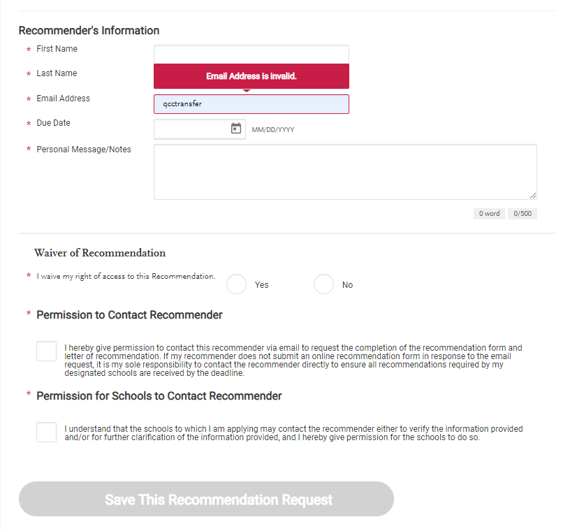
Create a Recommendation on Common App
Add Recommendation
Fill in required fields
It is recommended that students click “YES” to “I waive my rights to this recommendation
Click to give “Permission to Contact Recommender”
“Save This Recommendation Request”

Slide 18
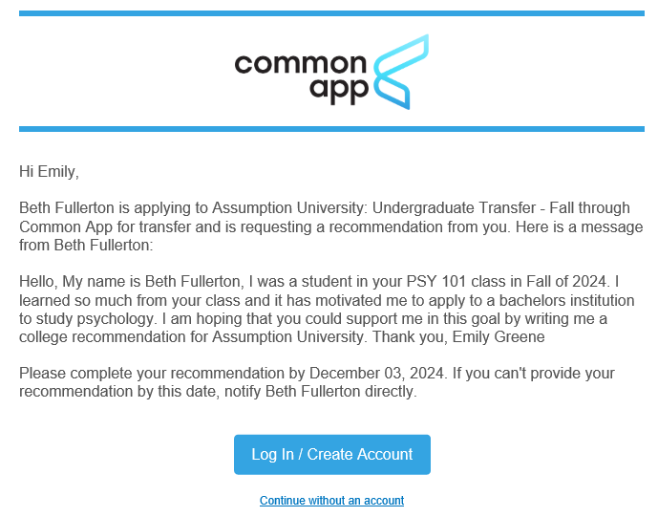
Example of what the Recommender will receive from Common App:

